Slide 1

P peline
The Data
Human Centered Issues in Data Acquisition
© Jennifer Mankoff
The Data Pipeline; HCII; Spring 2014

Slide 2
Jen’s Background
Notes:
Class exercise: do this on index cards and tape them up under the area of greatest expertise

Slide 3
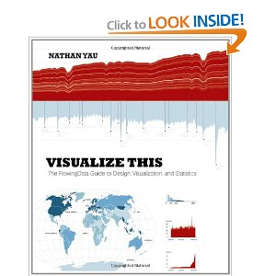
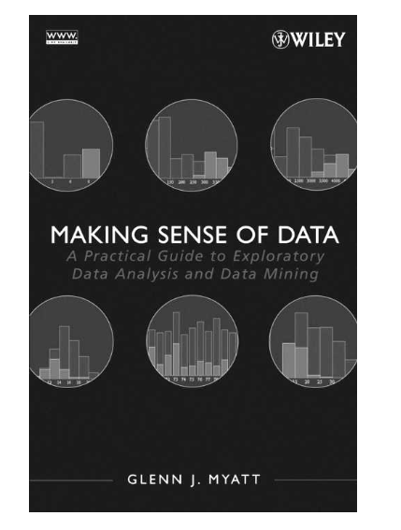

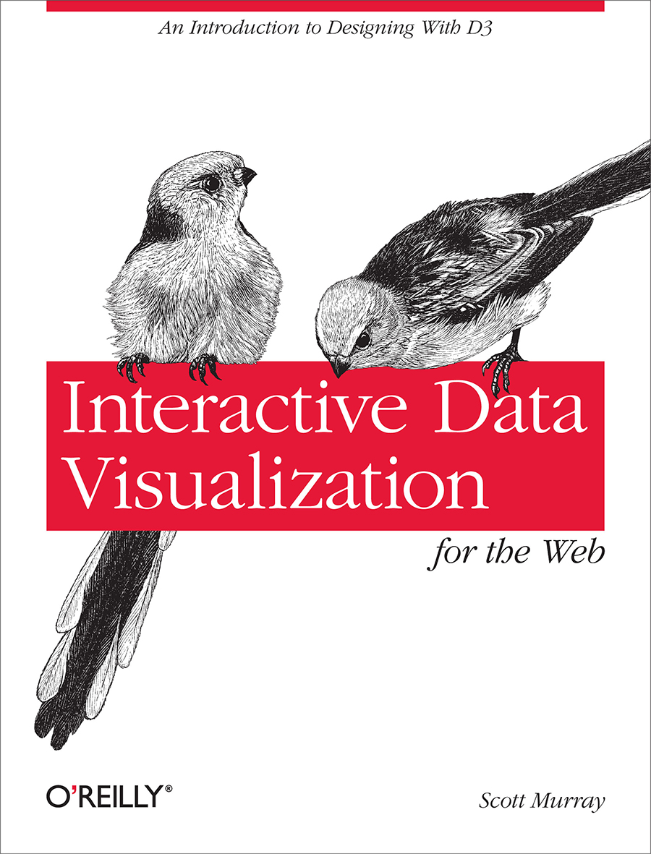
Recommended Texts

Slide 4
Where to find the class
Data.cmubi.org
https://github.com/jmankoff/data/
(Slides & Source code)

Slide 5
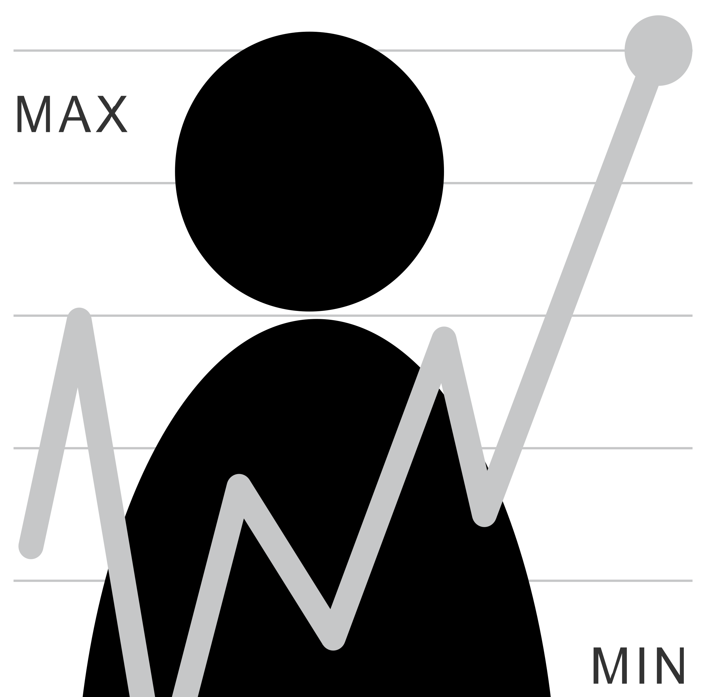
You know this but … It Starts With A Question
How much do I exercise?
What kind of question is this? Is it a good or a bad one? Can we rephrase it?
What sort of data could help answer it? What would a user need to do to collect good quality data? What would they do with the data?

Slide 6
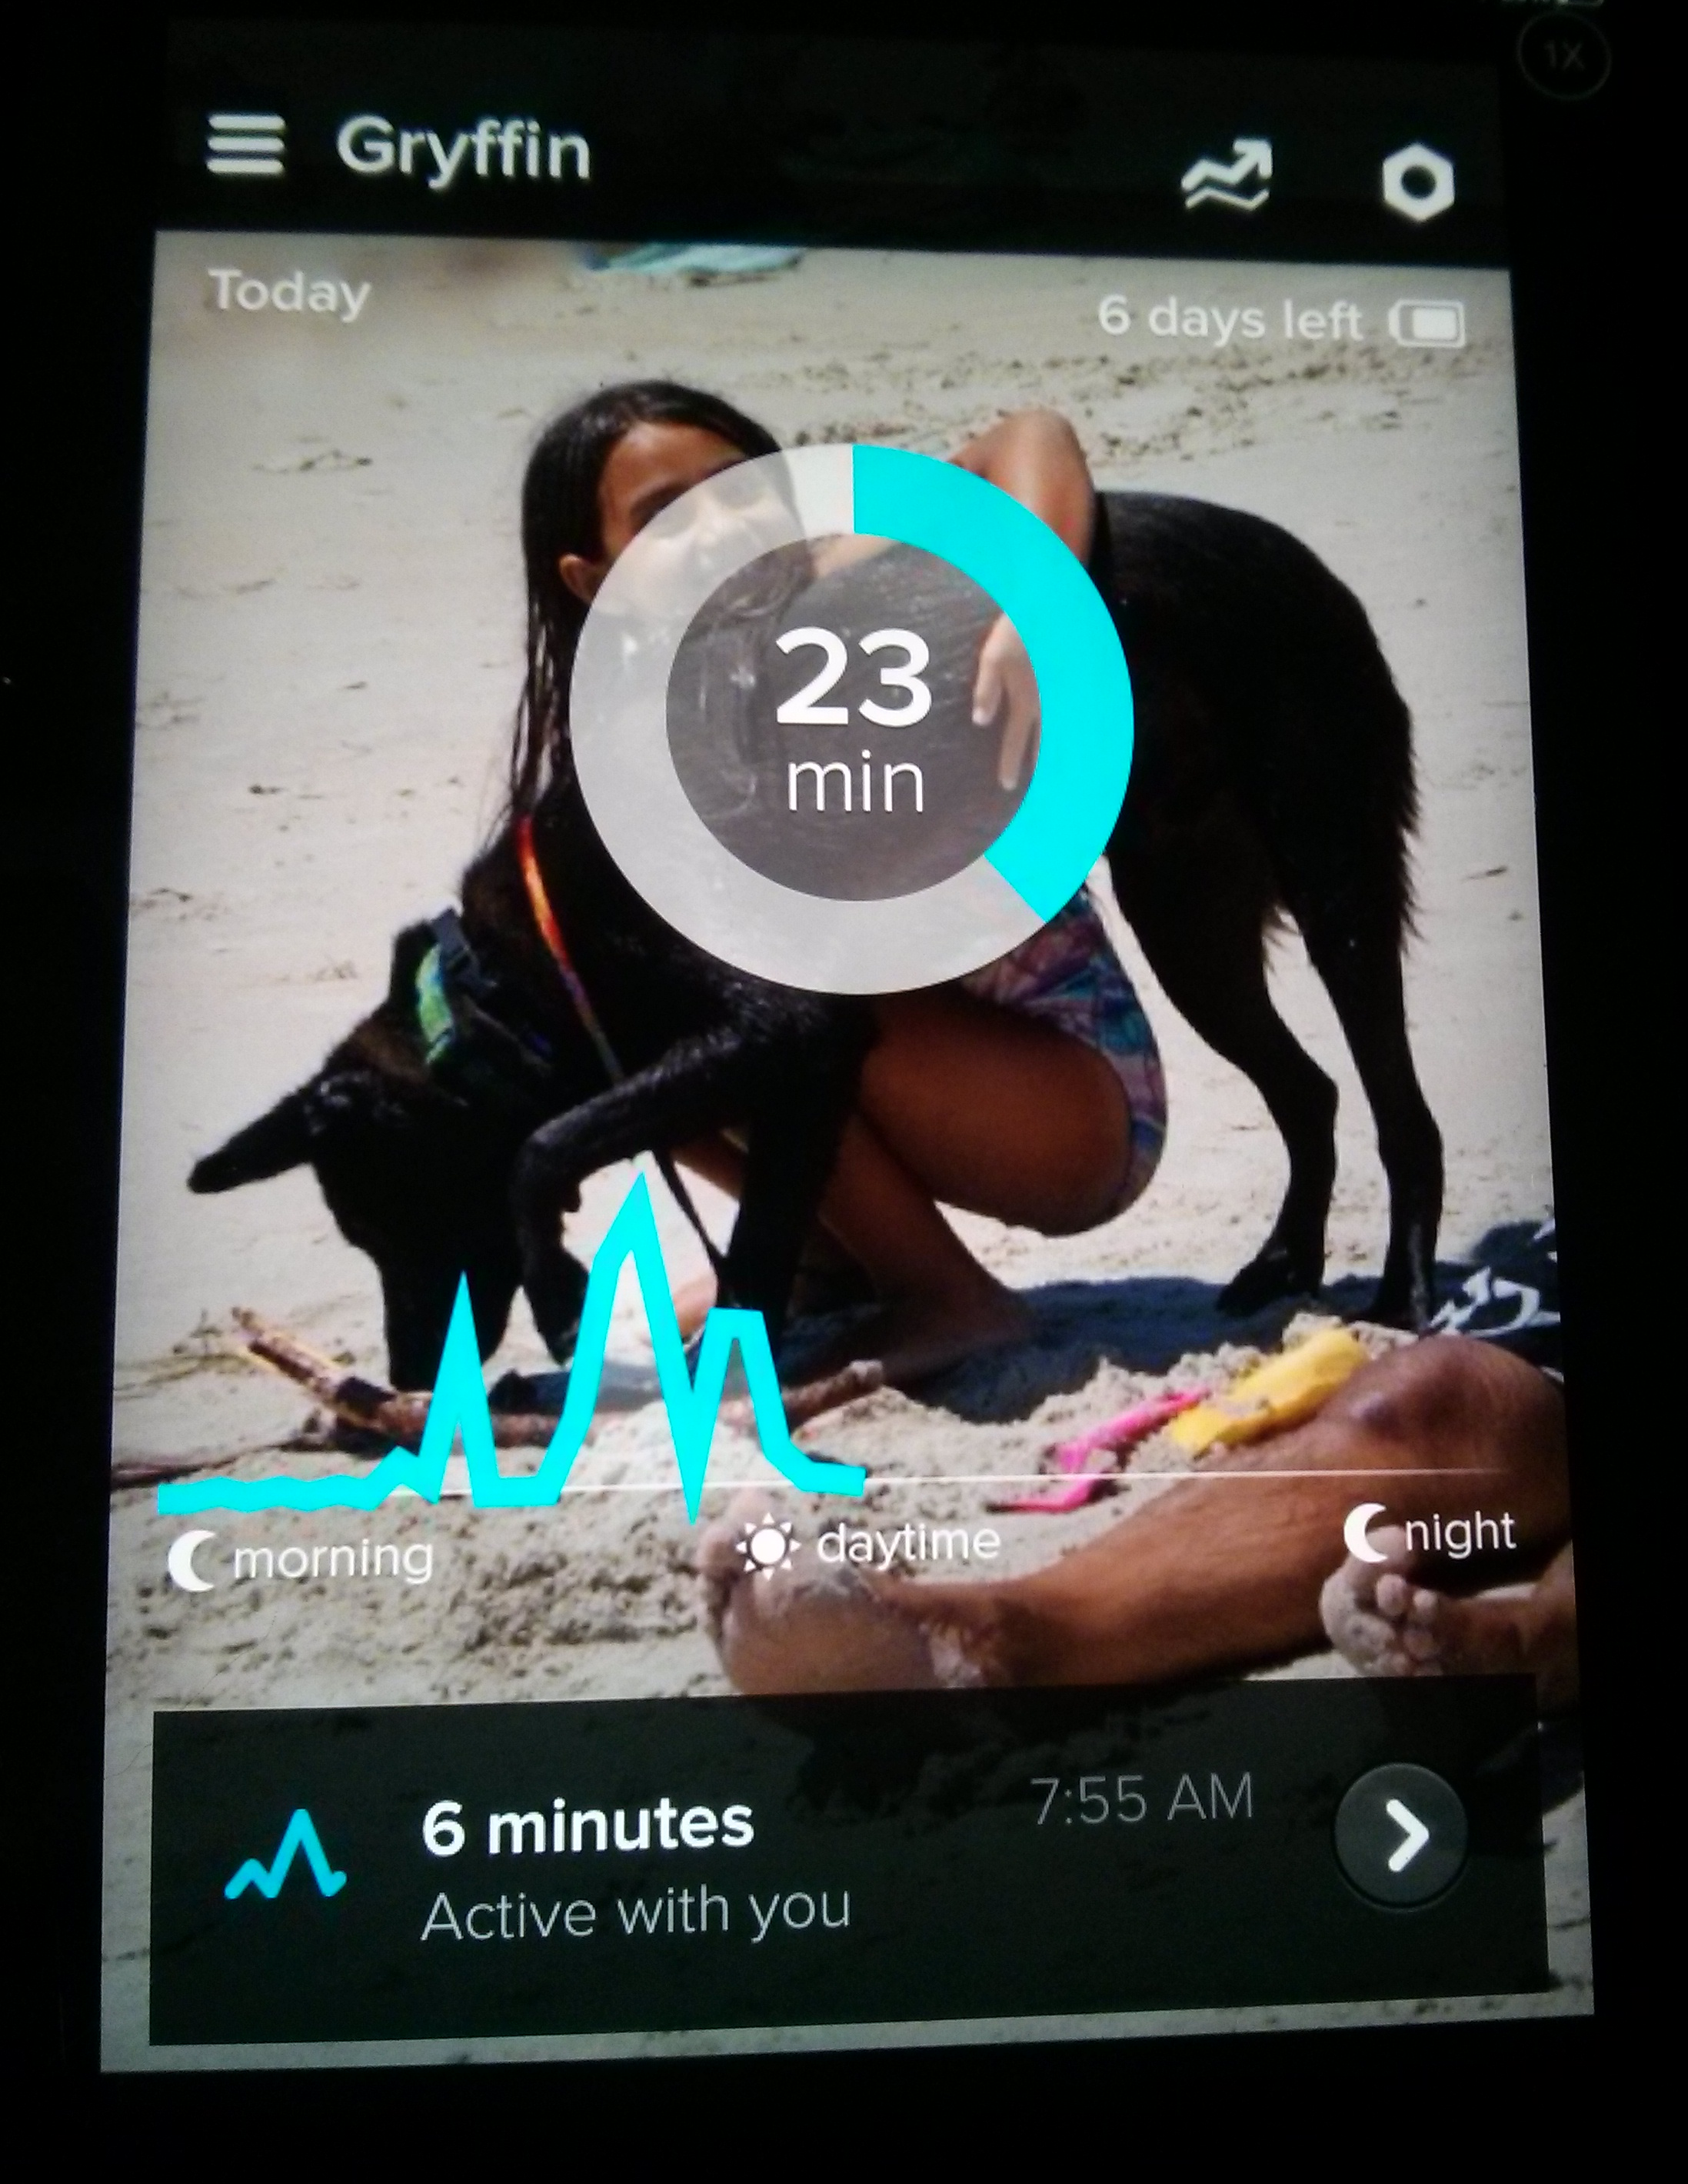
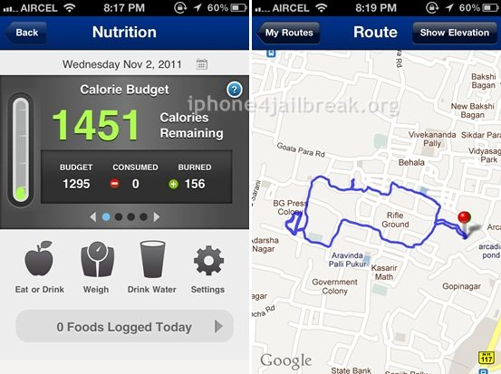
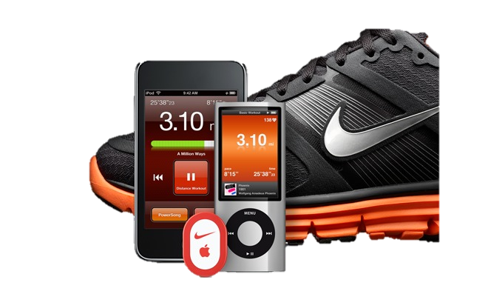
Example: Mobile data collection; Identifying activity

Slide 7
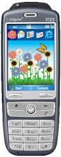
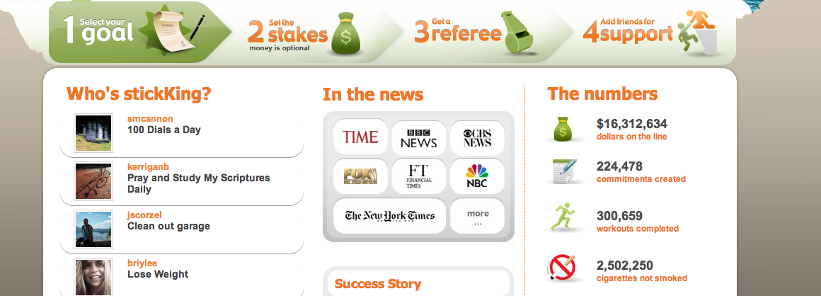
It’s not all about data…

Slide 8
It’s not all about data…
… and even if it was …

Slide 9
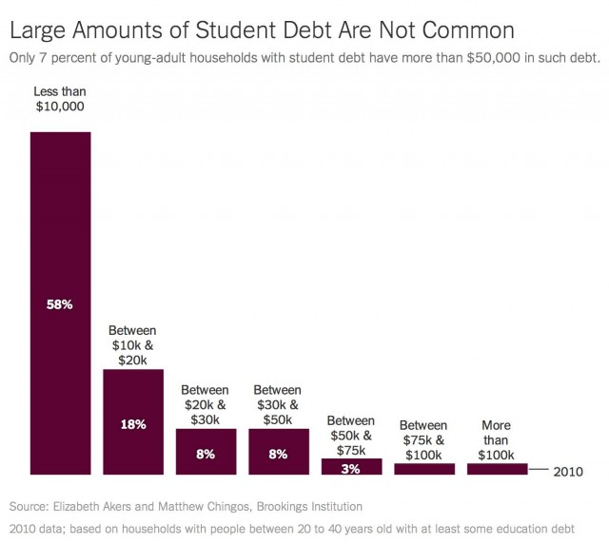
Can you trust your data?
Notes:
Do you see where that says "based on households with people between 20 to 40 years old with at least some education debt"? That's actually quite a bit of a fudge!
Those aren't households with people between 20 and 40; those are households headed by people between 20 and 40. Which is to say, this data excludes all people living in households headed by, say, their parents, or other adults. (36% of americans 18-31!)
includes college graduates from up to almost 20 years ago.
divided the amount of college debt by number of people in the household. So one person's $20,000 college debt becomes two people's $10,000 college debt.
only 1711 households, from 2010
high-income sample makes up approximately 25 percent of households in the SCF.
set aside as much as 1/3rd of people in the survey sample because they weren't paying off their student debt
Also visualization issues: lacks history: “student debt has risen over the last two decades (doubled since 1989). The median amount of debt—among those with debt—more than doubled, to $8,500 from $3,517, after adjusting for inflation.

Slide 10
Can you trust your data?
Just because you have a lot of data, does not mean that it is good data The plural of “anecdote” is not “data”.
Content borrowed from Bill Thies

Slide 11
Sources of Error
Sampling errors
Random Errors due to the sample forming only part of the population
Systematic Bias in sampling
Bias During Data Collection
Demand Characteristics
Illusory Superiority
Data entry / processing errors
Data is generated accurately but errors introduced during recording or processing
Notes:
Problems get worse when data is subjective

Slide 12
Where do we sample from?
Population about whom you are asking a question
‘response’ (the information we want from them)
Notes:
Examples of what this could be?
‘response’ is the data they generate
‘statistic’ is a measure of that variable across the entire sample
‘parameter’ is a a measure of that variable across the entire population

Slide 13
Where do we sample from?
‘response’ (the information we want from them)
Sample: The population we actually get responses from
Notes:
Examples of what this could be?
‘response’ is the data they generate
‘statistic’ is a measure of that variable across the entire sample
‘parameter’ is a a measure of that variable across the entire population

Slide 14
Independent Samples (infinite)
‘response’ (the information we want from them)
Notes:
Examples of what this could be?
‘response’ is the data they generate
‘statistic’ is a measure of that variable across the entire sample
‘parameter’ is a a measure of that variable across the entire population
the average of the sampling distribution is essentially equivalent to the parameter. (if we have a good sample) – the more samples the closer it gets.
A crucial midway concept you need to understand is the sampling distribution. In order to understand it, you have to be able and willing to do a thought experiment. Imagine that instead of just taking a single sample like we do in a typical study, you took three independent samples of the same population. And furthermore, imagine that for each of your three samples, you collected a single response and computed a single statistic, say, the mean of the response. Even though all three samples came from the same population, you wouldn't expect to get the exact same statistic from each. The distribution of an infinite number of samples of the same size as the sample in your study is known as the sampling distribution.
When we keep the sampling distribution in mind, we realize that while the statistic we got from our sample is probably near the center of the sampling distribution (because most of the samples would be there) we could have gotten one of the extreme samples just by the luck of the draw

Slide 15
‘Random’ Sampling Error
Generally decreases as the sample size increases (but not proportionally)
Depends on the variability of the characteristic of interest in the population
Notes:
the average of the sampling distribution is essentially equivalent to the parameter.
The standard deviation of the sampling distribution tells us something about how different samples would be distributed. In statistics it is referred to as the standard error. In sampling contexts it is called the sampling error
how do we calculate sampling error? We base our calculation on the standard deviation of our sample.
The bigger the sample, the closer your sample is to the actual population itself, the smaller the sampling error will be.
Let's assume we did a study and drew a single sample from the population. Furthermore, let's assume that the average for the sample was 3.75 and the standard deviation was .25. This is the raw data distribution depicted above. now, what would the sampling distribution be in this case? Well, we don't actually construct it (because we would need to take an infinite number of samples) but we can estimate it. For starters, we assume that the mean of the sampling distribution is the mean of the sample, which is 3.75. Then, we calculate the standard error. To do this, we use the standard deviation for our sample and the sample size (in this case N=100) and we come up with a standard error of .025 (just trust me on this). Now we have everything we need to estimate a confidence interval for the population parameter. We would estimate that the probability is 68% that the true parameter value falls between 3.725 and 3.775 (i.e., 3.75 plus and minus .025); that the 95% confidence interval is 3.700 to 3.800; and that we can say with 99% confidence that the population value is between 3.675 and 3.825. The real value (in this fictitious example) was 3.72 and so we have correctly estimated that value with our sample.
http://www.socialresearchmethods.net/kb/sampstat.php

Slide 16
‘Systematic Bias’ in Sampling
Does not decrease as the sample size increases (but not proportionally)
Depends on assumptions made by the experimenter about the population
Notes:
the average of the sampling distribution is essentially equivalent to the parameter.
The standard deviation of the sampling distribution tells us something about how different samples would be distributed. In statistics it is referred to as the standard error. In sampling contexts it is called the sampling error
how do we calculate sampling error? We base our calculation on the standard deviation of our sample.
The bigger the sample, the closer your sample is to the actual population itself, the smaller the sampling error will be.
Let's assume we did a study and drew a single sample from the population. Furthermore, let's assume that the average for the sample was 3.75 and the standard deviation was .25. This is the raw data distribution depicted above. now, what would the sampling distribution be in this case? Well, we don't actually construct it (because we would need to take an infinite number of samples) but we can estimate it. For starters, we assume that the mean of the sampling distribution is the mean of the sample, which is 3.75. Then, we calculate the standard error. To do this, we use the standard deviation for our sample and the sample size (in this case N=100) and we come up with a standard error of .025 (just trust me on this). Now we have everything we need to estimate a confidence interval for the population parameter. We would estimate that the probability is 68% that the true parameter value falls between 3.725 and 3.775 (i.e., 3.75 plus and minus .025); that the 95% confidence interval is 3.700 to 3.800; and that we can say with 99% confidence that the population value is between 3.675 and 3.825. The real value (in this fictitious example) was 3.72 and so we have correctly estimated that value with our sample.
http://www.socialresearchmethods.net/kb/sampstat.php

Slide 17
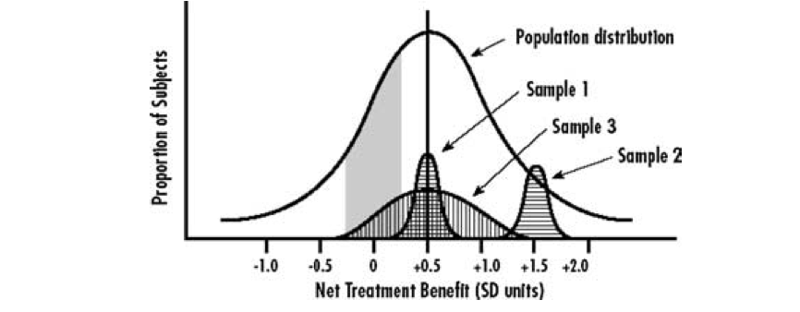
What Makes a Good Sample?
Representative of the population
(Along dimensions that matter to the question being asked)
Figure 1: Kravitz et al, (2004) Evidence-based medicine, heterogeneity of treatment effects, and the trouble with averages. The Milbank Quarterly 82(4):661-687
Notes:
Sample 1 is centered but not representative of true diversity. Sample 2 is biased (in this case, medical treatment, individuals who benefit more than most). Sample 3 is good (broadly representative in terms of risk, responsivity, and vulnerability)

Slide 18
Example: Medical Treatment Studies
For medical treatment we care about
Risk without treatment (baseline risk if untreated)
Responsiveness & Vulnerability to treatment (could be affected by biological or environmental differences) One is neg; one pos.
Notes:
What is worst is if the results are understood and applied without taking the sampling bias into account

Slide 19
Example: Lyme Disease
General Population

Slide 20
The CDC Estimates 300,000 per year contract Lyme disease

Slide 21
The CDC Estimates 300,000 per year contract Lyme disease
Our study (yellow circle) examines 3090 individuals drawn from those with chronic Lyme disease, a population that has not been studied previously
Notes:
What dimension matters here? How chronic their illness is!

Slide 22
Using Secondary Data for Verification
How do you determine the quality of the sample you have?
Compare demographics to ‘known, good’ samples (e.g., census data)
Needs to relate to variables of interest

Slide 23
The CDC Estimates 300,000 per year contract Lyme disease
The 5,000 cases on which our current understanding of Lyme Disease is based

Slide 24
The CDC Estimates 300,000 per year contract Lyme disease
Of these, the CDC found just 21 (1/2 %) had chronic Lyme disease

Slide 25
But what if your population looks like this?
Notes:
Bias in your sample…

Slide 26
The CDC Estimates 300,000 per year contract Lyme disease
But estimates suggest that approximately 36% of people with Lyme disease develop chronic symptoms
Of these, the CDC found just 21 (1/2 %) had chronic Lyme disease
Notes:
What does this tell us about the 5,000 person sample (if estimates are correct?)

Slide 27
The CDC Estimates 300,000 per year contract Lyme disease
Our study (yellow circle) examines 3090 individuals drawn from those with chronic Lyme disease, a population that has not been studied previously

Slide 28
Selection Bias
A statistical bias in which there is an error in choosing the individuals or groups to take part in a scientific study
Many potential sources
Sampling bias
Time of selection
Exposure to the study
Self-selection
Content borrowed from Bill Thies

Slide 29
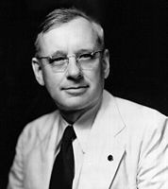
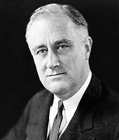

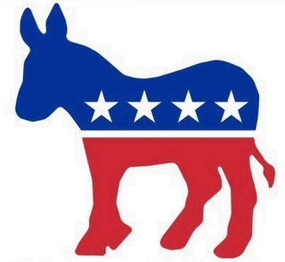
The Literary Digest Poll
1936 US Presidential Election
Alf Landon (R) vs. Franklin D. Roosevelt (D)
Slide Credit: Damian Gordon, Dublin Institute of Technology

Slide 30








The Literary Digest Poll
Slide Credit: Damian Gordon, Dublin Institute of Technology

Slide 31

The Literary Digest Poll
Literary Digest had been conducting successful presidential election polls since 1916
They had correctly predicted the outcomes of the 1916, 1920, 1924, 1928, and 1932 elections by conducting polls.
These polls were a lucrative venture for the magazine: readers liked them; newspapers played them up; and each “ballot” included a subscription blank.
Slide Credit: Damian Gordon, Dublin Institute of Technology

Slide 32
The Literary Digest Poll
In 1936 they sent out 10 million ballots to two groups of people:
Prospective subscribers, “who were chiefly upper- and middle-income people”
A list designed to "correct for bias" from the first list, consisting of names selected from telephone books and motor vehicle registries
Slide Credit: Damian Gordon, Dublin Institute of Technology

Slide 33

Slide Credit: Damian Gordon, Dublin Institute of Technology

Slide 34

The Literary Digest Poll
Response rate: approximately 25%, or 2,376,523 responses
Result: Landon in a landslide (predicted 57% of the vote, Roosevelt predicted 40%)
Slide Credit: Damian Gordon, Dublin Institute of Technology

Slide 35
The Literary Digest Poll
Response rate: approximately 25%, or 2,376,523 responses
Result: Landon in a landslide (predicted 57% of the vote, Roosevelt predicted 40%)
Election result: Roosevelt received approximately 60% of the vote
Slide Credit: Damian Gordon, Dublin Institute of Technology

Slide 36
The Literary Digest Poll
POSSIBLE CAUSES OF ERROR
Selection Bias: By taking names and addresses from telephone directories, survey systematically excluded poor voters.
Republicans were markedly overrepresented
In 1936, Democrats did not have as many phones, not as likely to drive cars, and did not read the Literary Digest
Any other causes?
Slide Credit: Damian Gordon, Dublin Institute of Technology

Slide 37
The Literary Digest Poll
POSSIBLE CAUSES OF ERROR
Non-response Bias: Because only 20% of 10 million people returned surveys, non-respondents may have different preferences from respondents
Indeed, respondents favored Landon
Greater response rates reduce the odds of biased samples
Slide Credit: Damian Gordon, Dublin Institute of Technology

Slide 38
Was there selection bias in our Lyme Disease sample?
We surveyed people in online mailing lists & used ‘snowball’ sampling
Other options?

Slide 39
Was there selection bias in our Lyme Disease sample?
We surveyed people in online mailing lists & used ‘snowball’ sampling
Other options?
Randomly call phone numbers in different regions
Hang out in doctors’ offices
Advertise on buses and billboards

Slide 40
Is there selection bias here?
Personal data can piggyback on existing devices (e.g., Make an android app people want to use (e.g. battery alerts) and give it free in return for data)
Public data can too (satellite data for example; or our current work with the Gates building)

Slide 41
Sources of Error
Sampling errors
Random Errors due to the sample forming only part of the population
Systematic Bias in sampling
Bias During Data Collection
Demand Characteristics
Illusory Superiority
Data entry / processing errors
Data is generated accurately but errors introduced during recording or processing
Notes:
Problems get worse when data is subjective

Slide 42
Experiment: Eye Witness Report
Content borrowed from Bill Thies

Slide 43
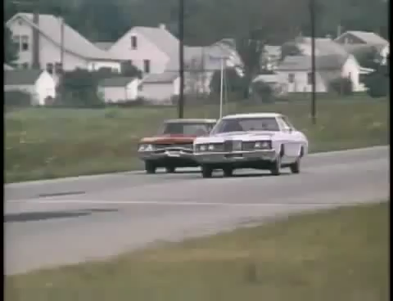
Content borrowed from Bill Thies

Slide 44
Answer the survey in front of you
Content borrowed from Bill Thies

Slide 45
Results Mean 53.5 vs 66

Slide 46
Speed estimate by verb condition
Loftus and Palmer (1974)
Condition Speed Estimate (mph)
smashed 40.8
collided 39.3
bumped 38.1
hit 34.0
contacted 31.8
WHY?
Credit: Jones, Lauwereyns, Wilshire, Victoria University of Wellington

Slide 47
One week later… Did you see anybroken glass?
Loftus and Palmer (1974)
Proportion of Ps giving a “yes” response.
Credit: Jones, Lauwereyns, Wilshire, Victoria University of Wellington

Slide 48
One week later… Did you see anybroken glass?
Loftus and Palmer (1974)
Proportion of Ps giving a “yes” response.
Condition “Yes” saw broken glass
smashed .32
hit .14
control .12 [no speed estimate]
Verb influenced not only speed estimates but memory for details of the event. False memory for broken glass.
Credit: Jones, Lauwereyns, Wilshire, Victoria University of Wellington

Slide 49
Demand Characteristics
An experimental artifact where participants form an interpretation of the experiment's purpose and unconsciously change their behavior to fit that interpretation
Content borrowed from Bill Thies

Slide 50
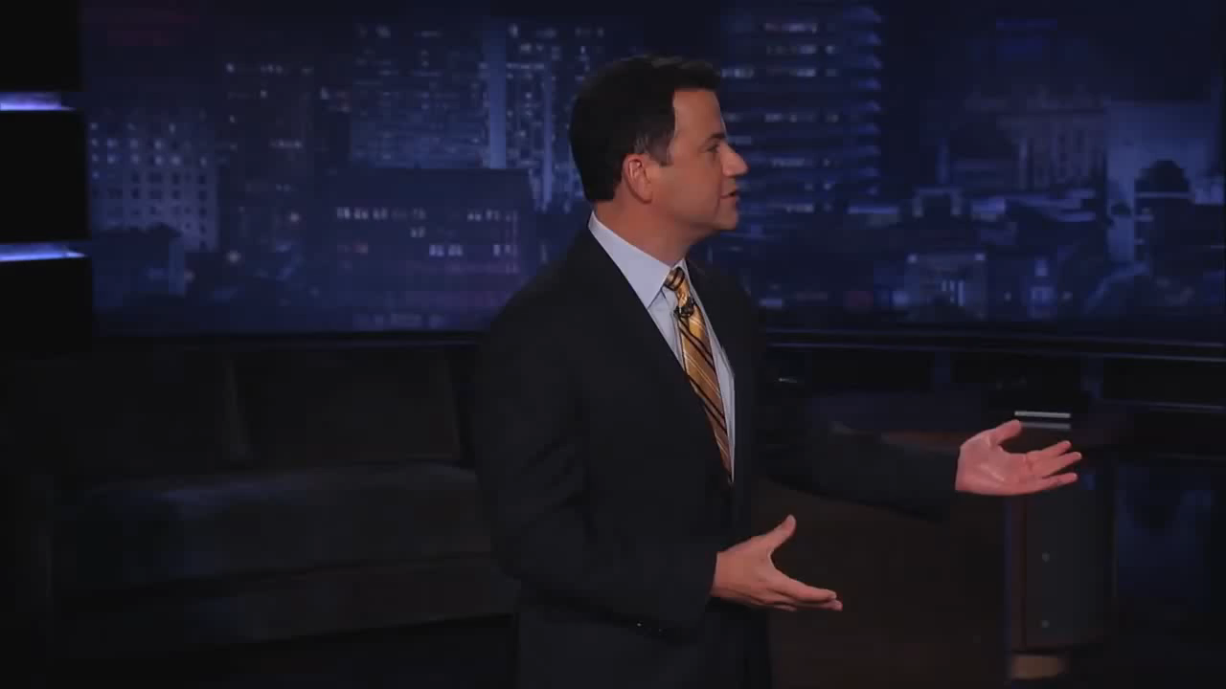
Content borrowed from Bill Thies

Slide 51
What can we do to minimize demand characteristics in HCI?
Be aware that response bias affects all studies
Dissociate from a particular design or solution
Minimize the differences in social status between investigators and participants
Use triangulation to validate data collected
Tricks for asking sensitive questions
Content borrowed from Bill Thies
41
Notes:
And lastly, use triangulation and alternative methodologies to validate any data collected. Avoid collecting subjective data. But be aware that quantitative data can also be affected.
Usage statistics and user performance can be affected as well.

Slide 52
Let’s try this on ourselves
We would like to know about what you think about how well you recognize humor. We want you to compare your own skill to the skills of the other people in this room. We want you to indicate your own estimated position in this group.
Of course, this is a difficult question because you may not know all of your classmates, much less how good their sense of humor is. But please make the most accurate estimate you can.
Content borrowed from Bill Thies
Notes:
https://www.usablestats.com/calcs/2samplet&summary=1

Slide 53
Survey
How good are you at recognizing humor, compared to peers such as those in this room?
Text your reply to 0798071549 or tweet @poll or go to http://www.polleverywhere.com/jmankoff
The content of your message should be 405151 XX, where XX is your percentile rank relative to others
Example: reply of 405151 99 means that you are a better listener than 99% of the people in this room.
Content borrowed from Bill Thies
Notes:
https://www.usablestats.com/calcs/2samplet&summary=1

Slide 54
Results 55

Slide 55
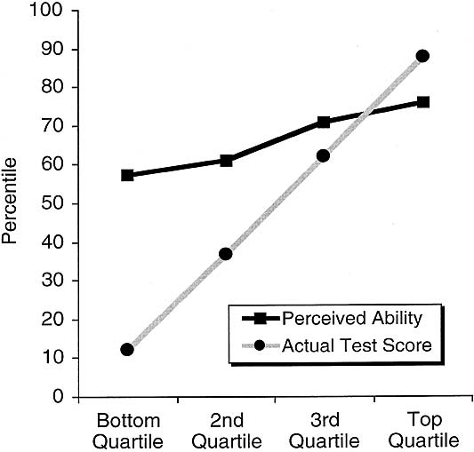
Ability to recognize humor
Krugar & Dunning (1999) “Unskilled and Unaware of It: How Difficulties in Recognizing One’s Own Incompetence Lead to Inflated Self-Assessments”
J. Pers & Soc. Psych.
Figure 1: Perceived ability to recognize humor … from gagne.homedns.org/~tgagne/contrib/unskilled.html#fig2
Notes:
The authors went on to demonstrate that ‘deficits in metacognitive skills mediate the link between low objective performance and inflated ability assessment’

Slide 56
Illusory superiority
A cognitive bias that causes people to overestimate their positive qualities and abilities and to underestimate their negative qualities, relative to others
Also known as:
above average effect
superiority bias
leniency error
sense of relative superiority
Content borrowed from Bill Thies

Slide 57
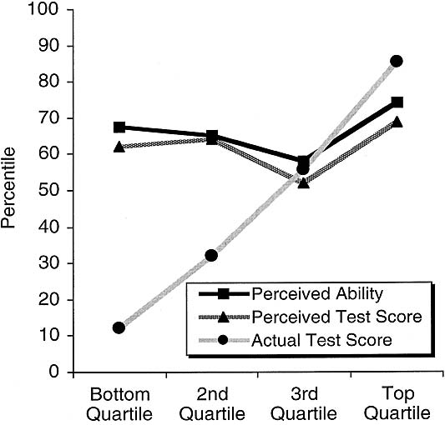
Replicated in many domains
“participants in the bottom quartile not only overestimated themselves but believed that they were above average.”
Figure 2: Perceived logical reasoning ability … from gagne.homedns.org/~tgagne/contrib/unskilled.html#fig2
Notes:
The authors went on to demonstrate that ‘deficits in metacognitive skills mediate the link between low objective performance and inflated ability assessment’… also see file:///Users/jmankoff/Downloads/incompetence.pdf

Slide 58
Also evidenced in studies of:
Memory
Cognitive tasks
Academic and job performance
Health
Popularity
Stock market trading
Taking lawsuits to trial
Content borrowed from Bill Thies

Slide 59
Measurement Errors
Badly Designed Questions
Double barreled (two in one)
Leading; Response ‘primed’
Intrusive
Answer impossible to recall
Skipped Question & ‘No’ indistinguishable
No correct category
Ambiguous
Inconsistent terminology

Slide 60
Measurement Errors
Badly Designed Questions
Badly Chosen Sensors
Invasive (may be turned off or covered up)
Incomplete (miss a large portion of the activity of interest)
Wrong level of detail

Slide 61
Measurement Errors
Badly Designed Questions
Badly Chosen Sensors
Bad Administration of Measurement Instrument
Long or badly formatted questionnaire
Non-objective collector/Non blinding
Respondent learning
Cultural Issues
Bad placement of sensor

Slide 62
Measurement Errors
Badly Designed Questions
Badly Chosen Sensors
Bad Administration of Measurement Instrument
Inaccurate Measurements
‘Proxy respondent’: Almost all data collection is a surrogate for the ‘real thing’
Regression to the mean
‘end aversion’
High sensor error
Notes:
http://en.wikipedia.org/wiki/Regression_toward_the_mean

Slide 63
Sources of Error
Sampling errors
Random Errors due to the sample forming only part of the population
Systematic Bias in sampling
Bias During Data Collection
Demand Characteristics
Illusory Superiority
Data entry / processing errors
Data is generated accurately but errors introduced during recording or processing
Notes:
Problems get worse when data is subjective

Slide 64
Curbstoning is a common threat to data quality.
Curbstoning – when survey interviewers fabricate some or all of their data.
Why could it happen?
Difficult-to-reach households
Embarrassing or uncomfortable questions
Incentive structures
In one survey, 13% of interviewers fabricated at least part of their interviews, despite close supervision.¹
An “epidemic” of curbstoning almost derailed an epidemiological study.²
¹Kiecker and Nelson, 1996
²Turner et al., 2002
Slide Credit: Benjamin Birnbaum, University of Washington
Notes:
Survey practitioners call this fabrication of data “curbstoning”. This name comes from the idea that instead of actually interviewing people, the interviewers are sitting on the curb, outside the house, making up data.
*There are a number of reasons that interviewers might fabricate data.
Maybe certain households are really difficult to reach. Or maybe some questions are uncomfortable to ask, such as questions about HIV, drug use, or other taboo subjects. Or maybe the incentive structures of the survey make it tempting to commit outright fraud because you’re paid based on the number of interviews that you do.
So how often does curbstoning happen? Hard statistics are hard to come by, but there are a few examples of studies that measure the prevalence of curbstoning.
*In one of these studies, it was found that 13% of interviewers fabricated at least part of their interviews, despite being in a closely supervised setting in a call center.
*In another study, researchers described what they called an “epidemic” of curbstoning that almost derailed their entire survey on drug use.
These are examples where researchers explicitly looked for curbstoning, but as you might imagine, it’s a problem in many surveys simply because it is faster and easier to fabricate data than to gather real data. I’ve talked to practitioners, and they say that they worry about the problem, they know that it happens, but it is often too difficult to and resource intensive to root it out.

Slide 65
Dealing with Curbstoning
Ask redundant questions and checks
Add other ways of monitoring data collection
Recently, some machine learning algorithms
Benjamin Birnbaum, U. Washington
Anomaly detection in data + user interface trace
Achieves good results on simulated curbstone data

Slide 66
Legitimate hole filling
When data is not ‘your own’ you don’t always know where the values come from
Collector may have addressed ‘missing values’ in ways you may or may not agree with

Slide 67
Implementation Issues
Loss of precision
Badly chosen algorithms for intermediate data analysis (categorization, location id, etc)
Repeated data
…

Slide 68
Four C’s of Data Quality
Is your data Complete?
Is your data Coherent?
Is your data Correct?
Is your data aCcountable?

Slide 69
Questions about Completeness
Appropriate Data: Does the data you have match the questions you want to answer?
Missing Data: Data does not exist because it was never obtained or was lost
Reporting error: The sensor (or respondent) is incorrect
Notes:
Look ahead … to the questions you’d like to answer
Reason back … to the data you’d need to collect

Slide 70
Solutions and Issues for Missing Data
Impute the data using statistics
Find an alternative source
Reweight the data to reflect the changed sample
Notes:
Example: we had data files whose names matched one participant but the directories matched a different participant name. The directories were done by hand, the file names were machine-generated. Which would you trust?

Slide 71
Is your Data Coherent?
Does the data “add up”?
Does it make sense relative to itself?
Are the extreme values?
Examples
Non number in a numeric field
Month field has something other than a month
Email has no @
Hourly data adds up to 24 hrs per day
Etc.

Slide 72
Nominal/Ordinal Field Data Inspection
How many are there?
Are they spelled consistently?
What is the frequency distribution of different values?

Slide 73
Interval/Ratio Field Data Inspection
Calculate min/max/mean; Make graphs!
- are there unexpected negative values? Very large targets/long motions/low velocity?
What outliers do you have?
- could represent measurement errors
- could be genuine
Do you have unexpected patterns
- can you see unexpected patterns (e.g. due to clutching)
Notes:
Need domain expertise to differentiate!

Slide 74
How do we address extreme values?
Outlier Treatment
Can drop them
Winsorization (replace with a less extreme value)
Replace missing value with a default. 0 was my default solution in explore.py
De-Duplication
Domain-based adjustments

Slide 75
How to detect and quantify skew?
A vector denoting presence/absence/percentage of data in each entity (location/person) ➔ glitch signature
Outlier detection techniques
Summary statistics
Graphs and Charts
Notes:
A value dij ∈ D is “clean” if and only if every value in vij is zero, that is the sum of the bits is 0. Glitch signatures can be considered augmented or derived data that enable us to flag glitches, quantify their prevalence, and identify patterns in an analytic, automated fashion.

Slide 76
Did we improve things?
Compare glitch index (sum of glitch signature) before and after
Check for statistical distortion (measure the distance from D to D*

Slide 77
Is your data Correct?
Itemize aspects of your data that are easy to verify
Compare (collect twice or find alt. source)
Analyze the data collection strategy and look for sources of bias
Within the population
across variables (surveys with only round values; people who report everything in round numbers)
Determine how much is bad

Slide 78
Quantify Impact
Are errors random or do they introduce bias
Are errors more likely in some variables than others
Is there a specific type of error you expect?
Can you go to the source and ask about error?

Slide 79
Is your Data Accountable?
Do you understand the provenance of the data?
Have you protected any end users or other people who could be traced?
Can you back up your claims about the data?
Do you have the original data as well as any modifications (version control?)
Who has access to the data?

Slide 80
Example analysis of 4 Data Sets
 | Augsburg Occupancy | CMU Occupancy | UCSD Movement | CMU Movement
Collection Method | Smart Door Plate | BACNet Sensor Queries | PDA-based WiFi triangulation | Phone-based WiFi Triangulation
Frequency | Every Room Change | Every 10 minutes | Every 20 sec | Every 30 sec, while movement is detected
Flaws | Summer and Fall data sets 4 month apart
Room vs. Floor vs. Campus | Covers 1 floor in an office building | Covers every floor in one university office building | Covers several campus buildings | Covers every floor in one university office building
Type | Transitional | Occupancy | Tracking | Tracking

Slide 81
Four Data Sets
 | Augsburg Occupancy | CMU Occupancy | UCSD Movement | CMU Movement
Scope | 4 People, (summer + [break] + fall) | 300 data points per day per room (temp & occupancy) | 275 students, M=11 weeks | 6 People
Total locations | 15 | 293 Rooms | 200 | 2074 (10x10 meter segments)
Days | M=23.25 (SD 3.42) | M=188.65 (SD 4.3) | M=25.56 (SD 20.81) | M=58.1 (SD 32.57)
Data points per person/day | M=316.60 (SD 8.55) | N/A | M=508.46 (SD 739.1) | M=497.65 (SD 273.96)
Locations per person/day | M=6.70 (SD 0.70) | N/A | M=3.45 (SD 2.68) | M=44.97 (SD 10.67)

Slide 82
Completeness?
Augsburg Occupancy:
Due to the smart doorplate only transitional data from one space to another is available.
The summer and fall data sets are nearly four month apart. Problem?
Notes:
Some glitches are difficult to define (or correct)
University schedules change a lot … maybe really be two separate data sets.

Slide 83
Completeness?
UCSD Movement:
The number of data points were not equally distributed over all user, some left their device on all the time, but others only collected one days worth of data
All data sets:
Some locations have much more data than others
Issue: is skew a glitch or a feature?
Notes:
Others are quantifiable

Slide 84
Example: Graph of prime locations
Notes:
What do you notice?
The most frequent location (Top 1) constitutes 50% of the data
Is this what we expect?

Slide 85
UCSD Data Set Skew

Slide 86
Example: UCSD Data Set

Slide 87
Example: UCSD Data Set

Slide 88
Recommended Reading
The Bad Data Handbook (McCallum): O’Reilly Press
Making Sense of Data: A practical guide to Exploratory Data Analysis and Data Mining
Tukey: Exploratory Data Analysis

Slide 89
Summary
Address as many issues as possible when you plan your sample & data collection strategies
Check for all of the same issues if you are using someone else’s data!

